Slide 1
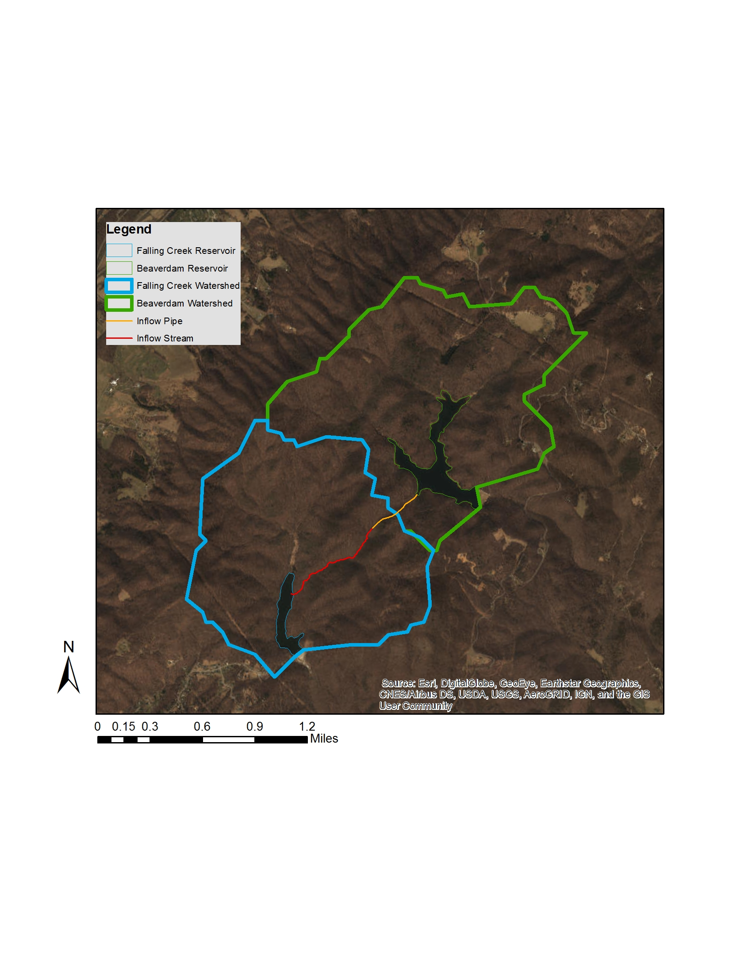
B 200
B 100
B30
B20
B45
B01
B50
F 200
F 102
F 101
F 100
F20
F 99
F30
F45
F50
F01

Slide 2
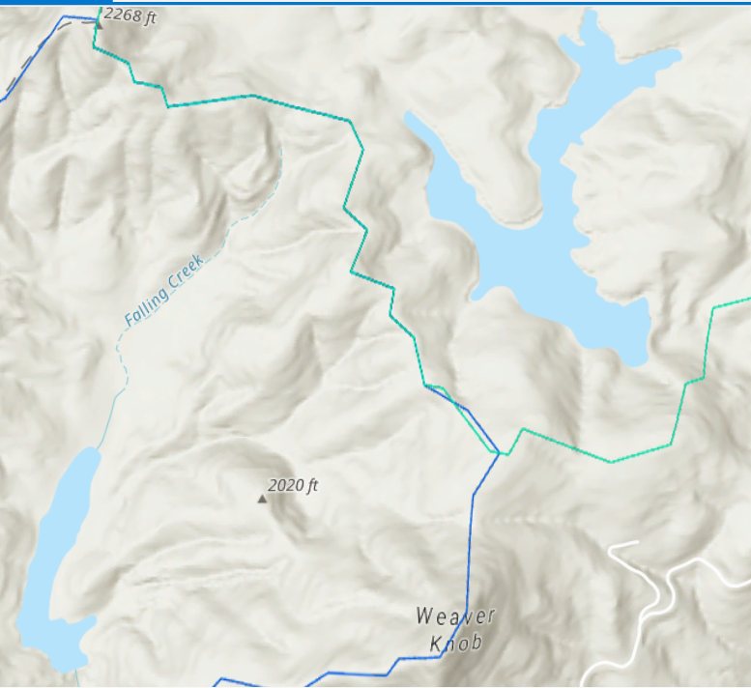
B200
B100
B30
B20
B45
B01
B50
F102
F200
F101
F100
F20
F99
F30
F45
F50
F01

Slide 3
B200
1.72/1.72
B100
0.52
Chlorophyll-a concentrations from 29APR19 continuum day
B30
2.1/2.2
B20
1.9
B45
2.9
B01
2.2
F102
2.23
F101
1.72
B50
2.9
F200
0.98
F20
2.06
F100
1.5/1.23
F99
0.98
F30
2.2
F45
2.2
F50
2.06/2.2
F01
1.5

Slide 4
B200
1.7/1.7
B100
0.52
Chlorophyll-a concentrations from 30May19 continuum day
B30
1.7/1.7
B20
1.5
B45
1.03
B01
1.03
F102
0.9
F101
0.5
B50
1.4
F200
0.7
F20
4.8
F100
0.7/0.5
F99
0.5
F30
4.6
F45
4.6/4.5
F50
3.8
F01
0.9
Notes:
Think about the magnitude of change along the cont within the reservoir, secchi at deep hole for both days as a measure of water clarity

Slide 5
B200
B100
B30
B20
B45
B01
B50
F102
F200
F101
F100
F20
F99
F30
F45
F50
F01
Notes:
Sites for Dexter’s BDOC experiment

Slide 6
Trying to come up with a consistent naming convention. For BVR I’ve labeled them according to west or east, and then their respective within-reservoir locations (R = riverine, T = transitional, L = lacustrine
For FCR, it’s a little less straight forward because the sites already have numbers. I think we should either just leave them (and they will have different naming convention from BVR)
I also have started to wonder if we need to measure site 40 in FCR. We have a much higher-spatial comparison in FCR than in BVR and I think we could get away with dropping it. What do you think?

Slide 7
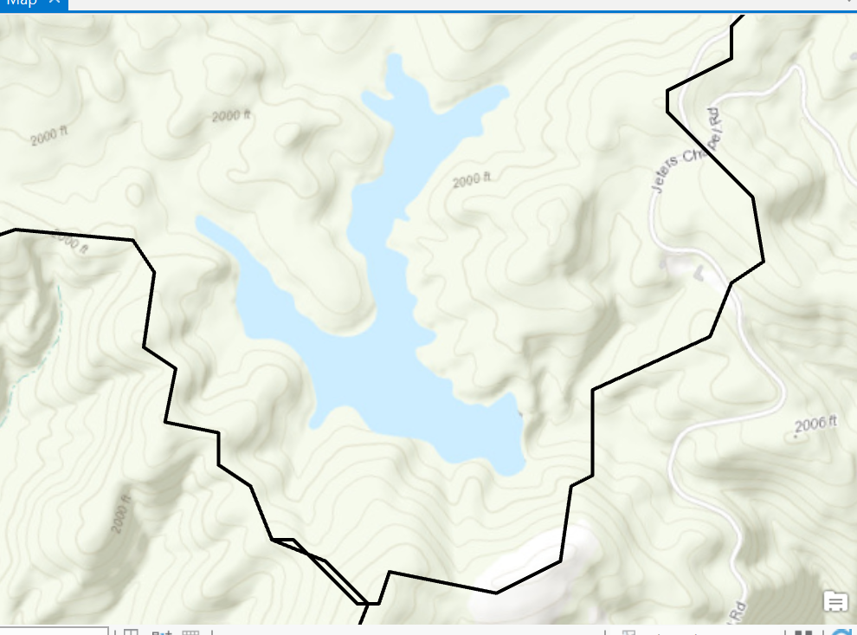
N = 7 BVR sites

Slide 8
BVR inf 2
BVR inf 1

Slide 9
WET
weir
20
N = 11 FCR sites
30
40
45
50
Notes:
About 1km from emergence of water form pipe to FCR shoreline

